Slide 1
web application using react js

Slide 2
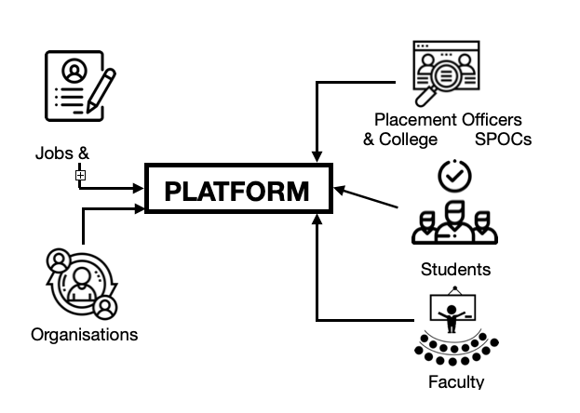
Problem statement
Design a platform which connects multiple organisational stakeholders to help students find matching jobs for their profile. The functionality of the platform is depicted below:

Slide 3

prototype
A web application designed using React , in which a student can apply for a job:

Slide 4

A student can signup and login to the website:

Slide 5
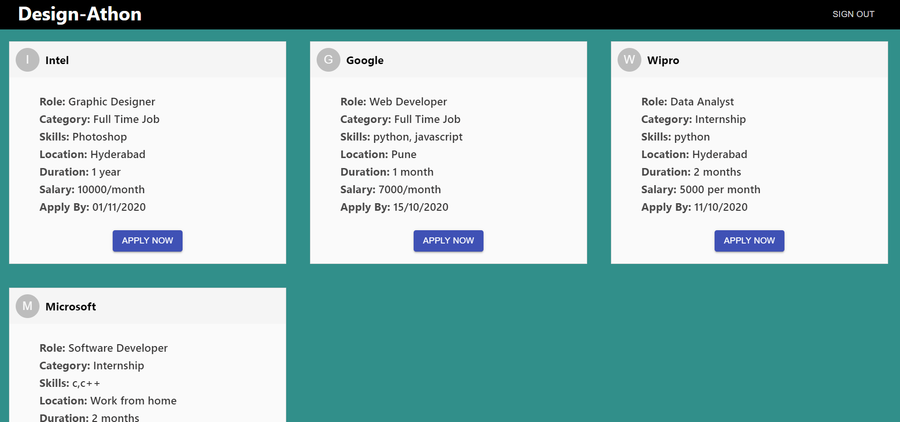
After login, Student can search for the job and apply for that job:

Slide 6
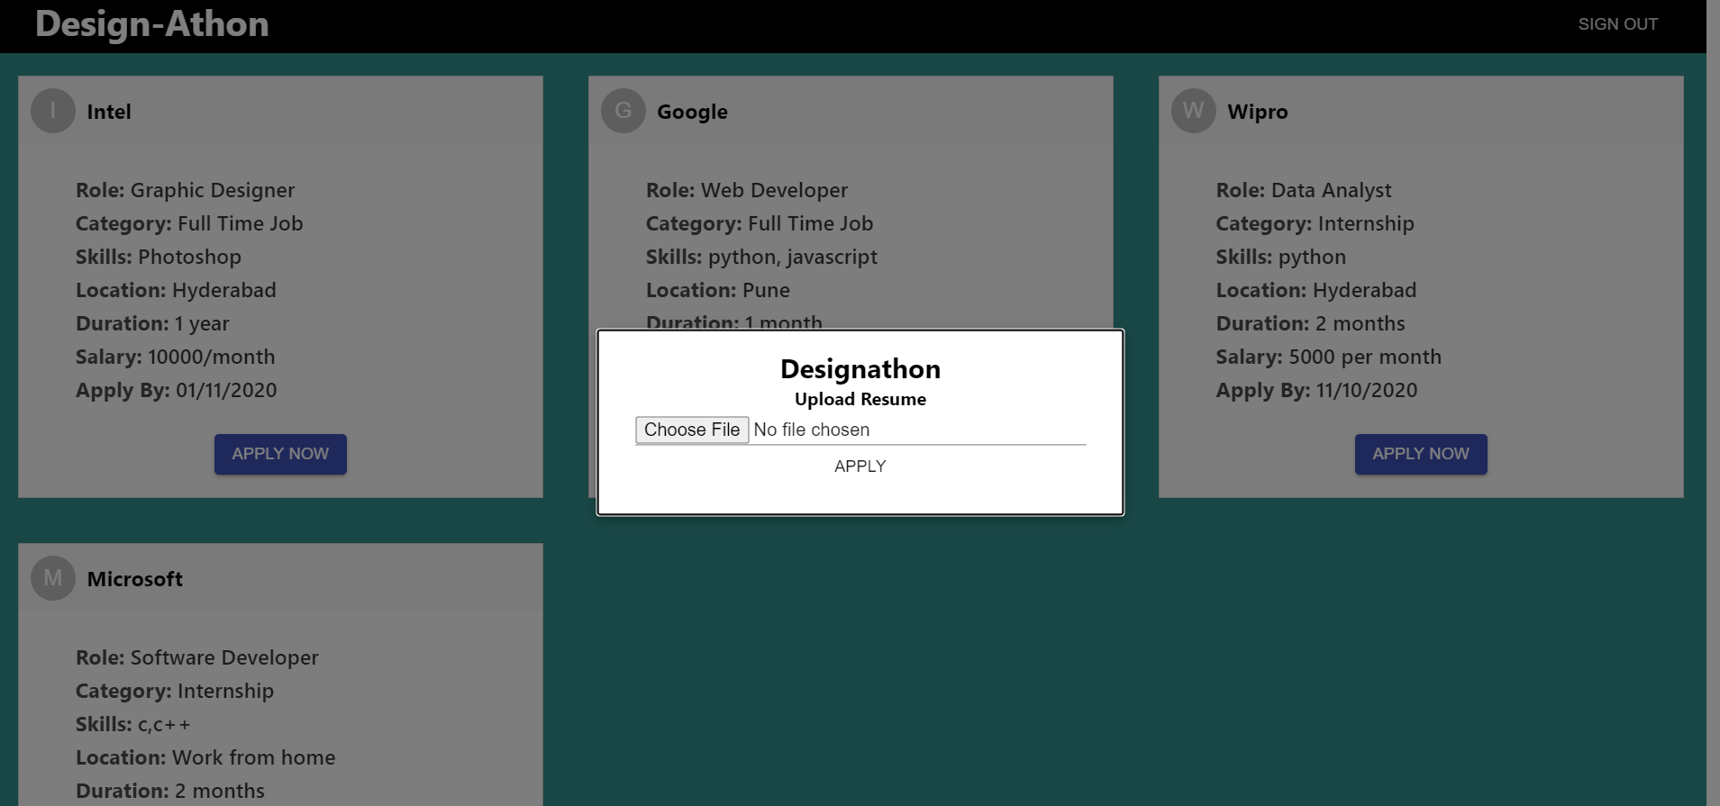
On clicking apply now button , student can upload their resume and apply for the job:

Slide 7
THANKYOU

